Slide 1
Forest Fires Severity Classification using Machine Learning
Presented By:
Samia Maliha -2254901043 Ishrat Jahan Binti -2254901071
Presented To:
Sarnali Basak
Associate Professor, CSE, JU
Jasiya Fairiz Raisa
Lecturer, ICT, BUP

Slide 2

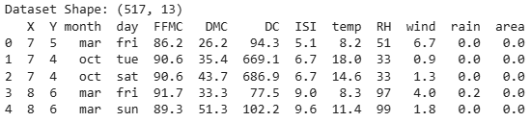
Dataset Information
Total Records: 517
Total Features: 13
Includes:
Weather data → temperature, RH , wind, rain
Fire indices → FFMC, DMC, DC, ISI
Location → X, Y
Time → month, day
Target Column :
area → burned area of forest

Slide 3
Why "Area" is the Target?
Area represents the burned forest area (fire damage).
Our goal is to predict how severe a fire is.
Therefore area is used as the target variable .
Why we convert it to classification
Area is continuous numeric data.
Converting it into severity levels

Slide 4
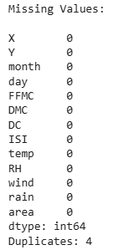


Data Preprocessing
Missing Values:
No missing values found
Duplicate Values:
4 duplicate rows removed

Slide 5
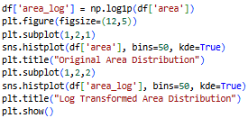
Log Transformation
Creates a new column called area_log
Applies log transformation to the area column
Why?
Area is highly skewed (many 0s, few large values)
Log transformation reduces skewness and makes data more balanced
bins=50 → divides data into 50 parts
kde=True → adds smooth curve

Slide 6
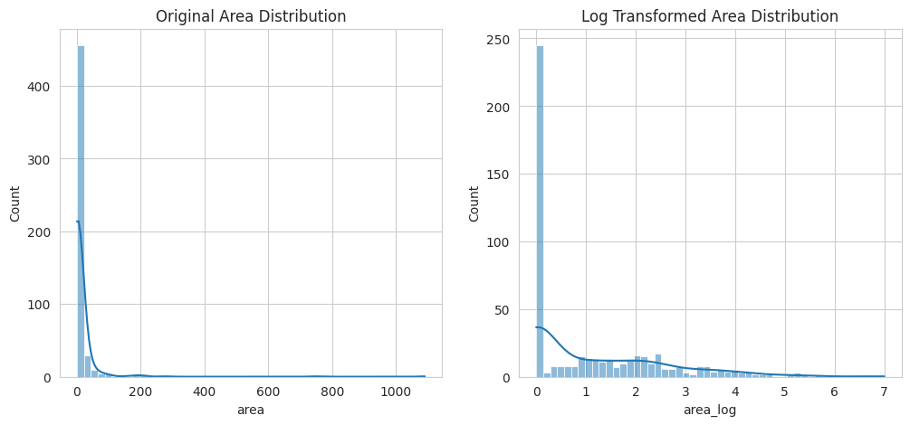
Log Transformation Cont.

Slide 7
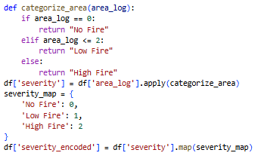
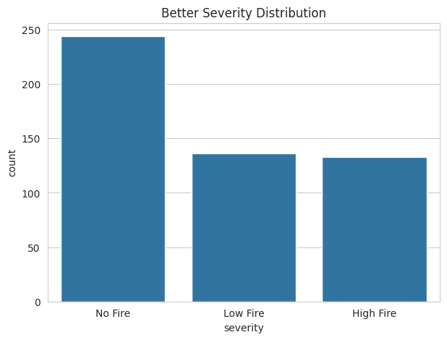
Severity Categorization
We convert area_log into three classes (No Fire, Low Fire, High Fire) to represent fire severity. Final output: severity_encoded used as the model target variable.

Slide 8

One-Hot Encoding
Month & Day are categorical
Applied One-Hot Encoding to convert into numeric value
Example:
month → month_jan, month_feb, …
day → day_mon, day_tue, …

Slide 9
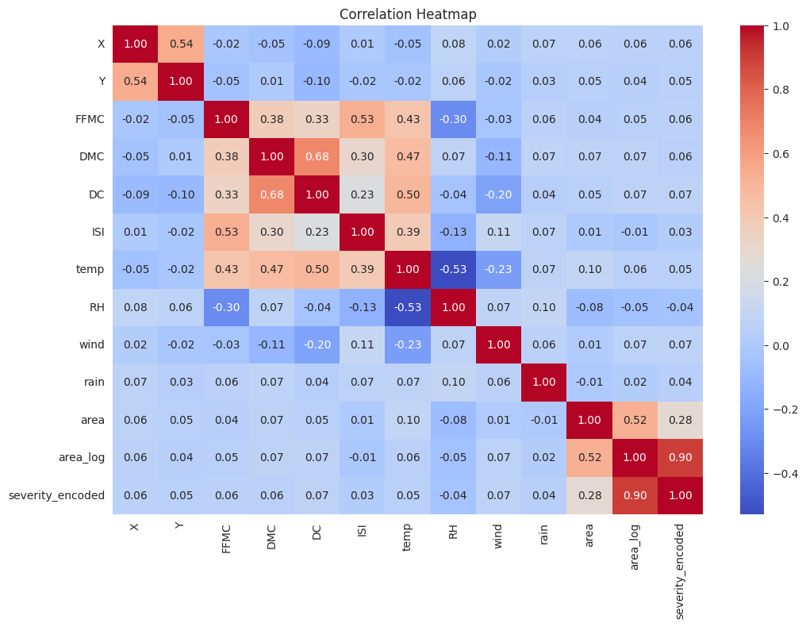
Correlation Heatmap

Slide 10
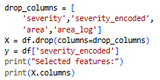



Feature & Target Selection
TRAIN TEST SPLIT

Slide 11

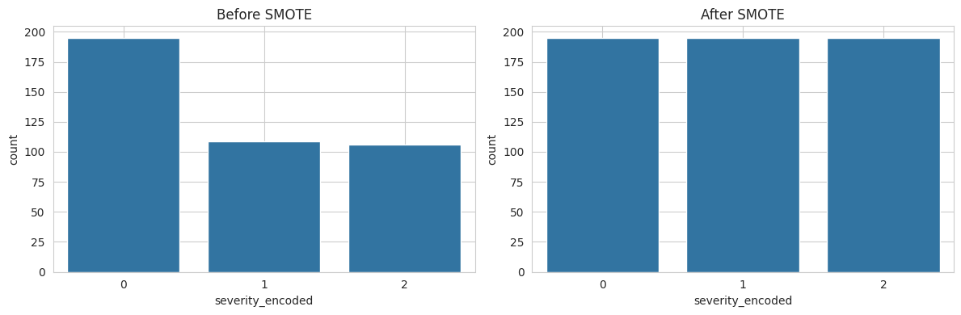
SMOTE for Class Balancing
We apply SMOTE only on the training data to balance class distribution for minority classes. This helps improve model performance by preventing bias toward majority classes.

Slide 12
Models used for forest fire dataset
Random Forest
Gradient Boosting
Models
K-Nearest Neighbors (KNN)
LINEAR REGRESSION

Slide 13
Why These Models Were Used
K-Nearest Neighbors (KNN)
Dataset is relatively small (517 samples), which suits KNN
Works well for multi-class classification
Uses similarity between weather conditions to classify fire severity
Random Forest
Works well with mixed weather + fire index features (FFMC, DMC, DC, etc.)
Handles non-linear relationship between features and fire severity
Gives stable results even with noisy data
Gradient Boosting
Improves performance by learning from errors
Captures complex patterns in data
Captures small changes in weather conditions affecting fire

Slide 14
Random Forest
Random Forest is a machine learning model that uses many decision trees together.
It combines their results to give more accurate and stable predictions.
Why Random Forest does NOT need scaling?
Random Forest is a tree-based model. It splits data using thresholds (rules),
not distance .
Why SMOTE is used?
Create synthetic samples for minority classes
Balance training data
This helps Random Forest learn all classes better

Slide 15
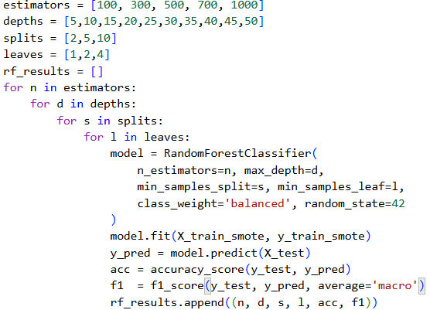
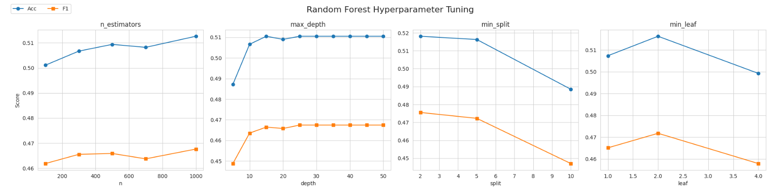
Model Hyperparameter Tuning
estimators → number of trees in forest
depths → limits tree depth
splits → minimum samples to split a node
leaves → minimum samples in leaf node
class_weight ='balanced' → handles class imbalance
random_state =42 → ensures same results every run

Slide 16
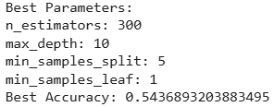
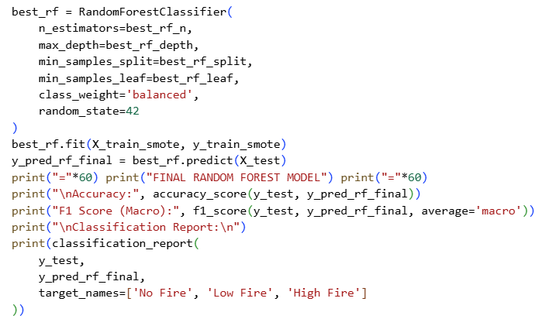
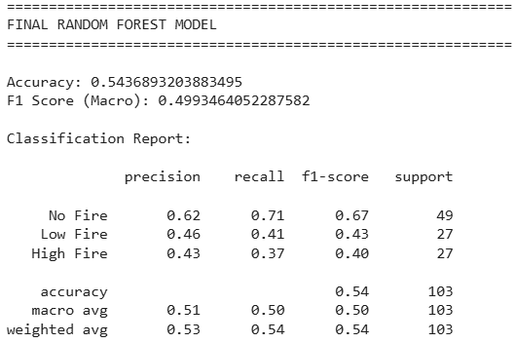
Best RF Model Selection and Train

Slide 17
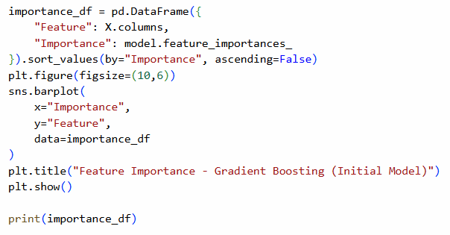
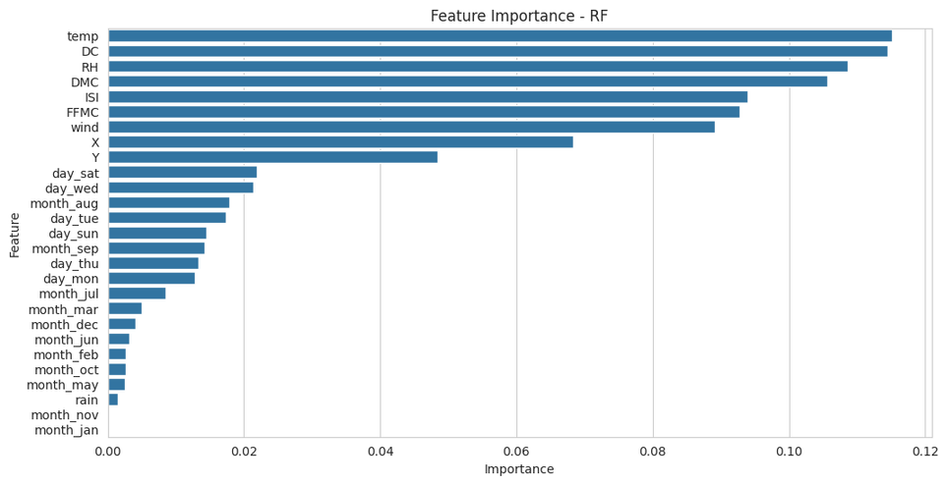
Feature Importance

Slide 18
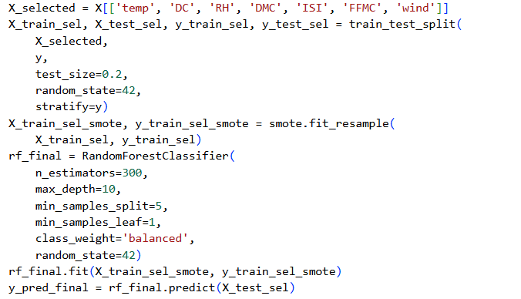
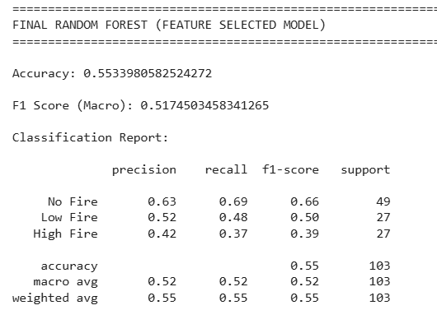
Model Training on Selected Features

Slide 19
Gradient Boosting
Gradient Boosting is a machine learning model that builds many small decision trees step by step. Each new tree learns from the mistakes of the previous ones to improve performance.
Why scaling is NOT needed in Gradient Boosting?
Gradient Boosting uses decision trees, which split data using rules, not distance.
So feature scaling does not affect its performance.
Why SMOTE is used?
SMOTE is used to balance the dataset by creating new synthetic samples for minority classes.

Slide 20
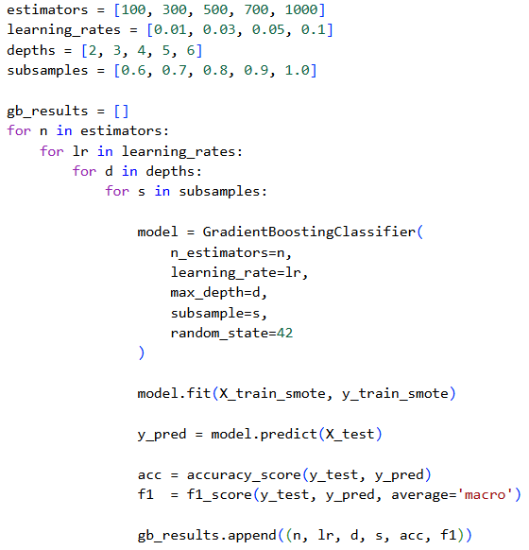
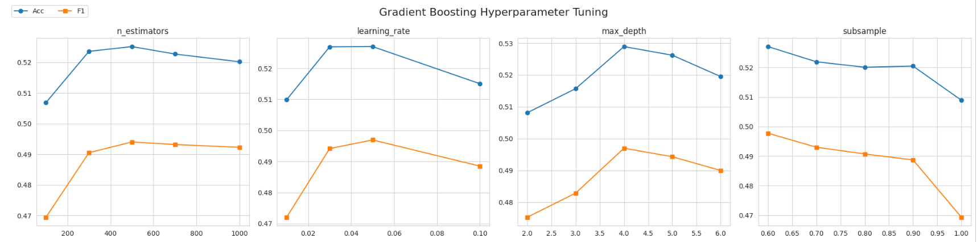
Model Hyperparameter Tuning
n_estimators → Number of trees used in the model
learning_rate → How much each tree contributes to learning
max_depth → Maximum depth of each tree
random_state → Fixes randomness for same results every time

Slide 21
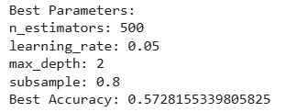
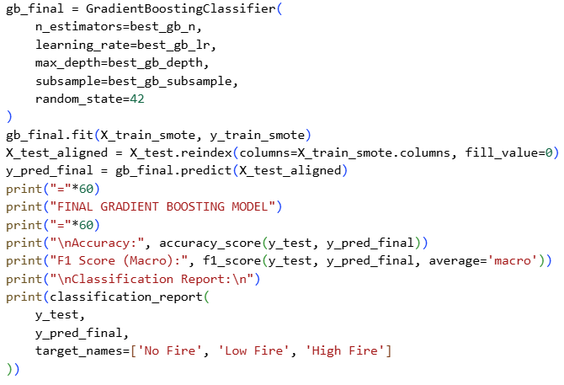
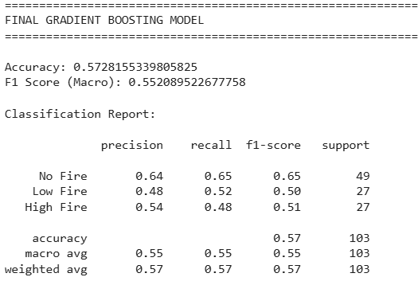
Best GB Model Selection and Train

Slide 22
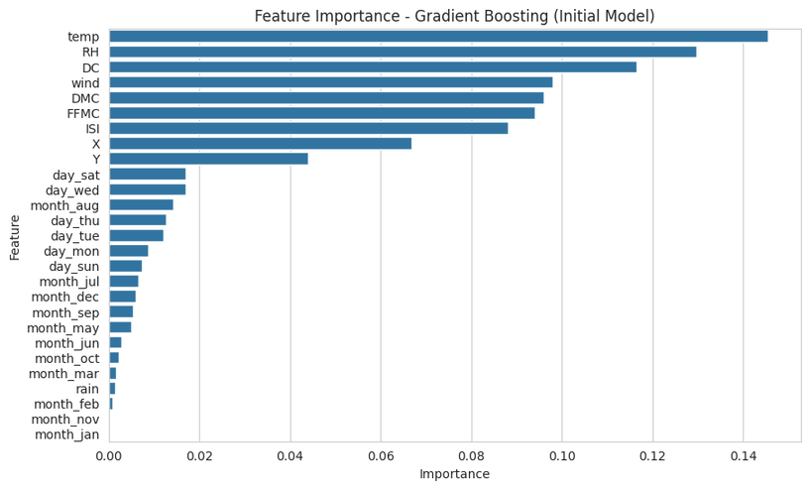
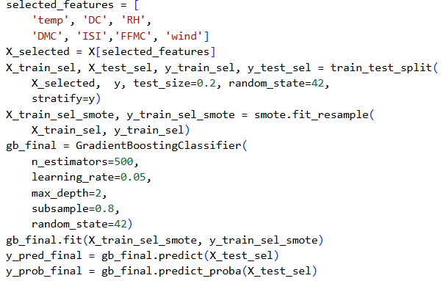
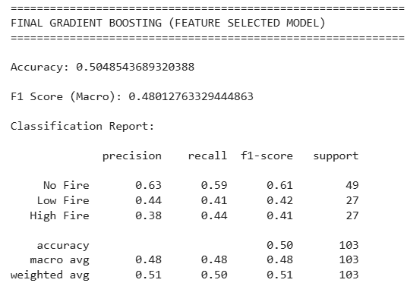
Feature Importance and Model Training on Selected Features

Slide 23
KNN (K-Nearest Neighbors)
KNN (K-Nearest Neighbors) is a machine learning model that classifies data based on the nearest similar data points.
Why scaling is needed in KNN?
KNN is a distance-based model, so features with large values can dominate the distance calculation. Scaling makes all features equal in importance. We use standard scaling here
Why SMOTE is NOT used in KNN?
KNN works directly with the original data points to find nearest neighbors So it does not need synthetic samples

Slide 24
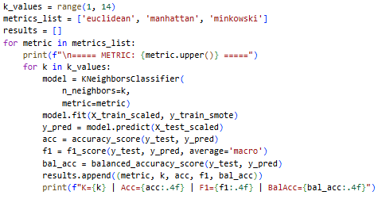
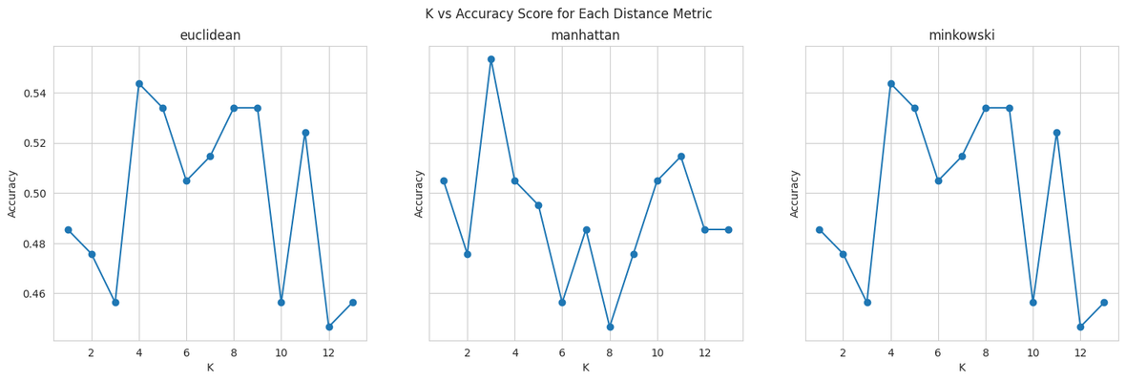
Model Hyperparameter Tuning
Tested different distance metrics:
Euclidean (straight-line distance)
Manhattan (grid-based distance)
Minkowski (general form of both)
Tested different values of K (neighbors):
K = 1 to 13
Used scaled data (StandardScaler) for fair distance calculation

Slide 25

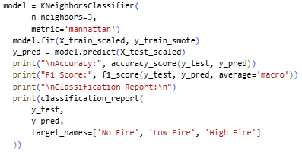
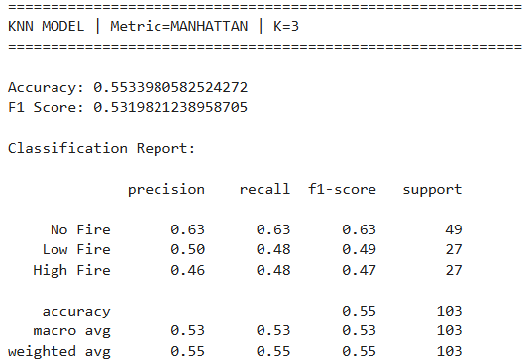
Best KNN Model Selection and Train

Slide 26
Logistic Regression
Logistic Regression is a classification algorithm that predicts the probability of a binary outcome (0 or 1) using input features and a sigmoid function.
Why scaling needed in Logistic Regression?
Logistic Regression is a distance-based linear model that uses gradient optimization. So features with larger scales can dominate the learning process.
Why SMOTE is used?
SMOTE is used to balance the dataset by creating new synthetic samples for minority classes.

Slide 27
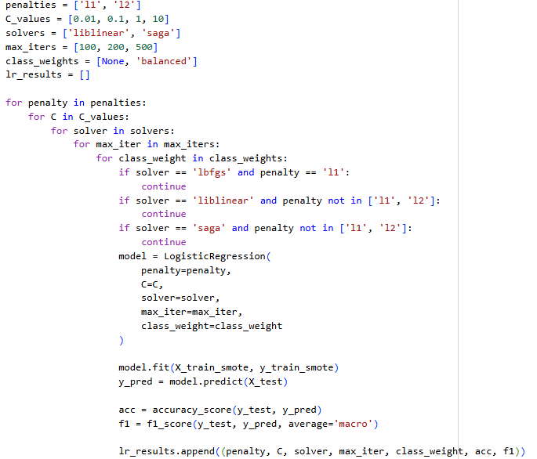
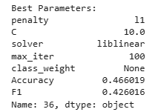
.
Model Hyperparameter Tuning
penalties: Controls regularization to prevent overfitting and select features.
C_values: Sets strength of regularization.
Solvers: Optimization methods used to train the model.
max_iters: Maximum iterations allowed for the model to converge.
class_weights: Adjusts weights to handle imbalanced classes.
lr_results: Stores results of different Logistic Regression experiments

Slide 28
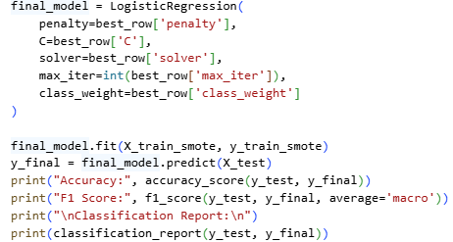
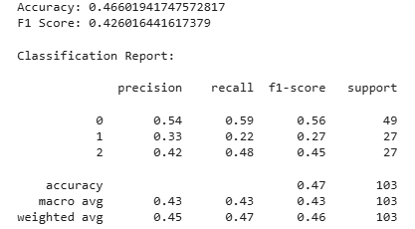
Best LR Model Selection and Train

Slide 29
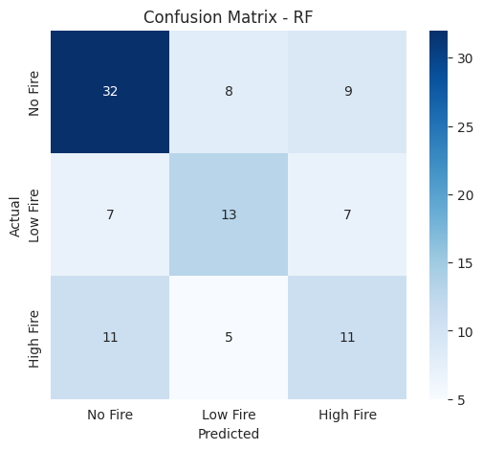
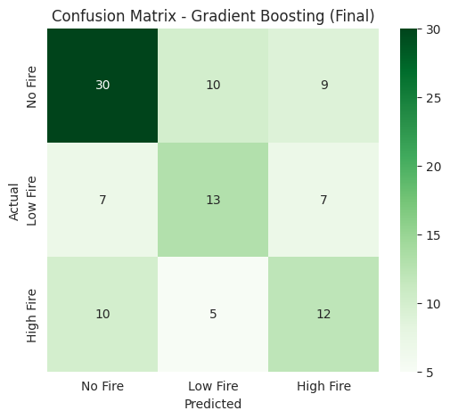
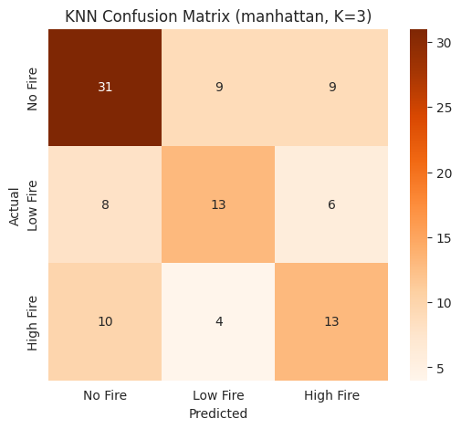
Confusion Matrix
Random Forest
Gradient Boosting
K Nearest Neighbors

Slide 30
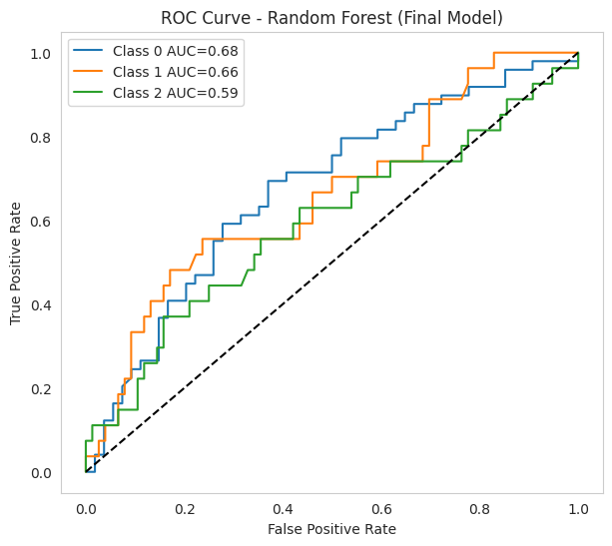
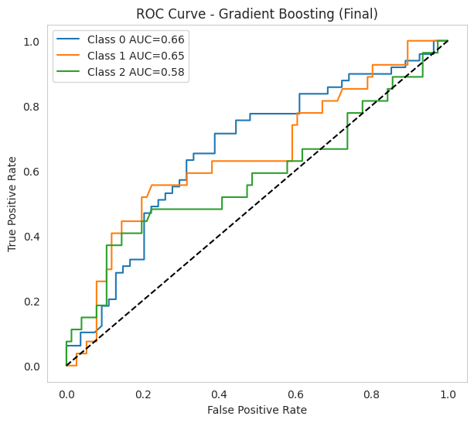
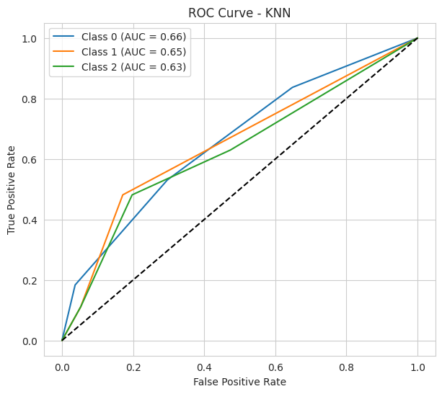
ROC Curve
Random Forest
Gradient Boosting
K Nearest Neighbors

Slide 31
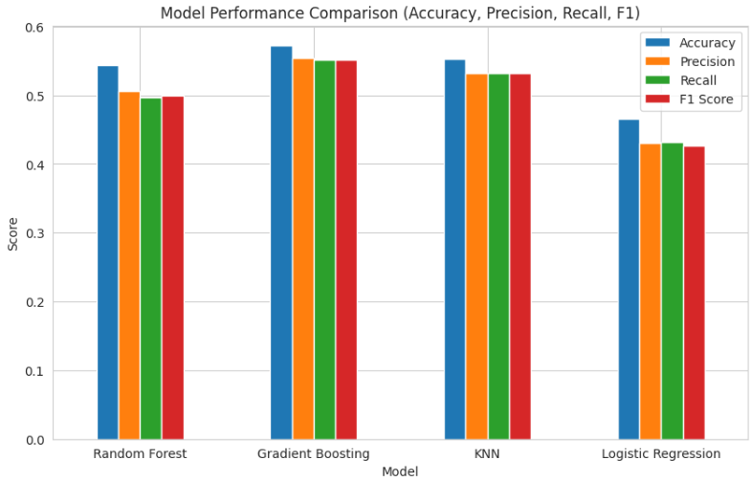
Final Model comparison

Slide 32
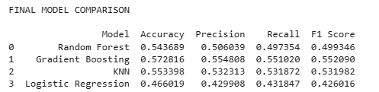
Best Model
Which Model is Best ?
Dataset is imbalanced → Accuracy alone is not reliable
Use F1 Score along with the Accuracy
Comparing all models Gradient Boosting has the highest F1 Score and Accuracy.
Why Gradient Boosting Performs Best?
Works well on small datasets (517 samples)
Scaling improved distance calculation
Captures patterns between similar data points
Other models (RF, KNN, LR) slightly weaker on minority classes

Slide 33
Thank You

